Slide 1
Lending Library Team
Tareq Alomar, Cody Barrett, Nick Harper, Jacob Levy, Nick Volenec

Slide 2
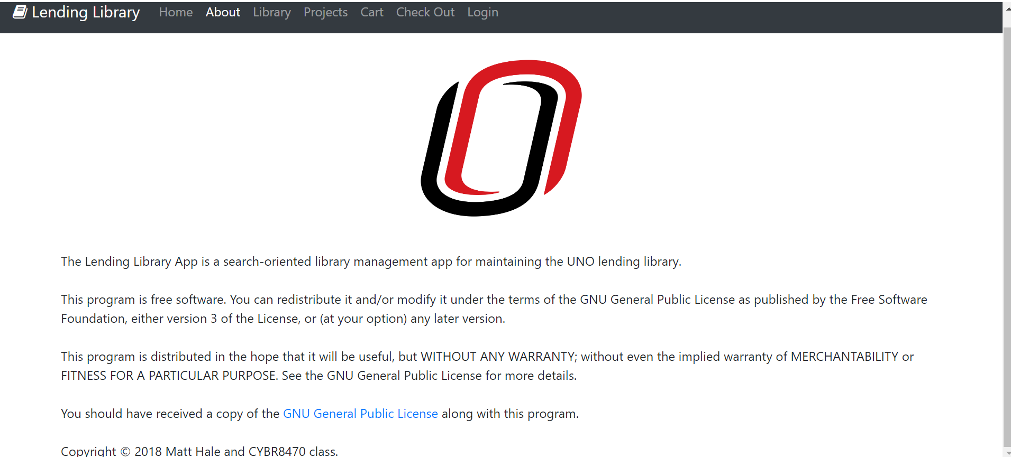
Efforts Made
Focus on modifying the database to our projects needs.
Frontend functionality has also been worked on to a lesser extent.
User Authentication
Inventory display
Cart functionality

Slide 3



Outcomes
Learned the basics of the Django, and Ember.js frameworks.
Created our own development environments using Docker.

Slide 4
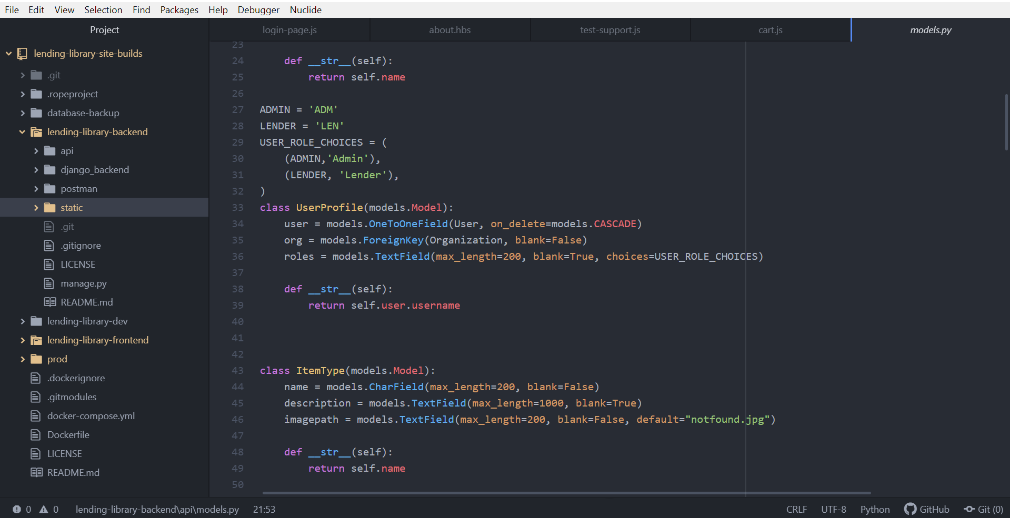
Outcomes
Familiarized ourselves with the existing codebase.
Began modifying the frontend codebase for our use.

Slide 5
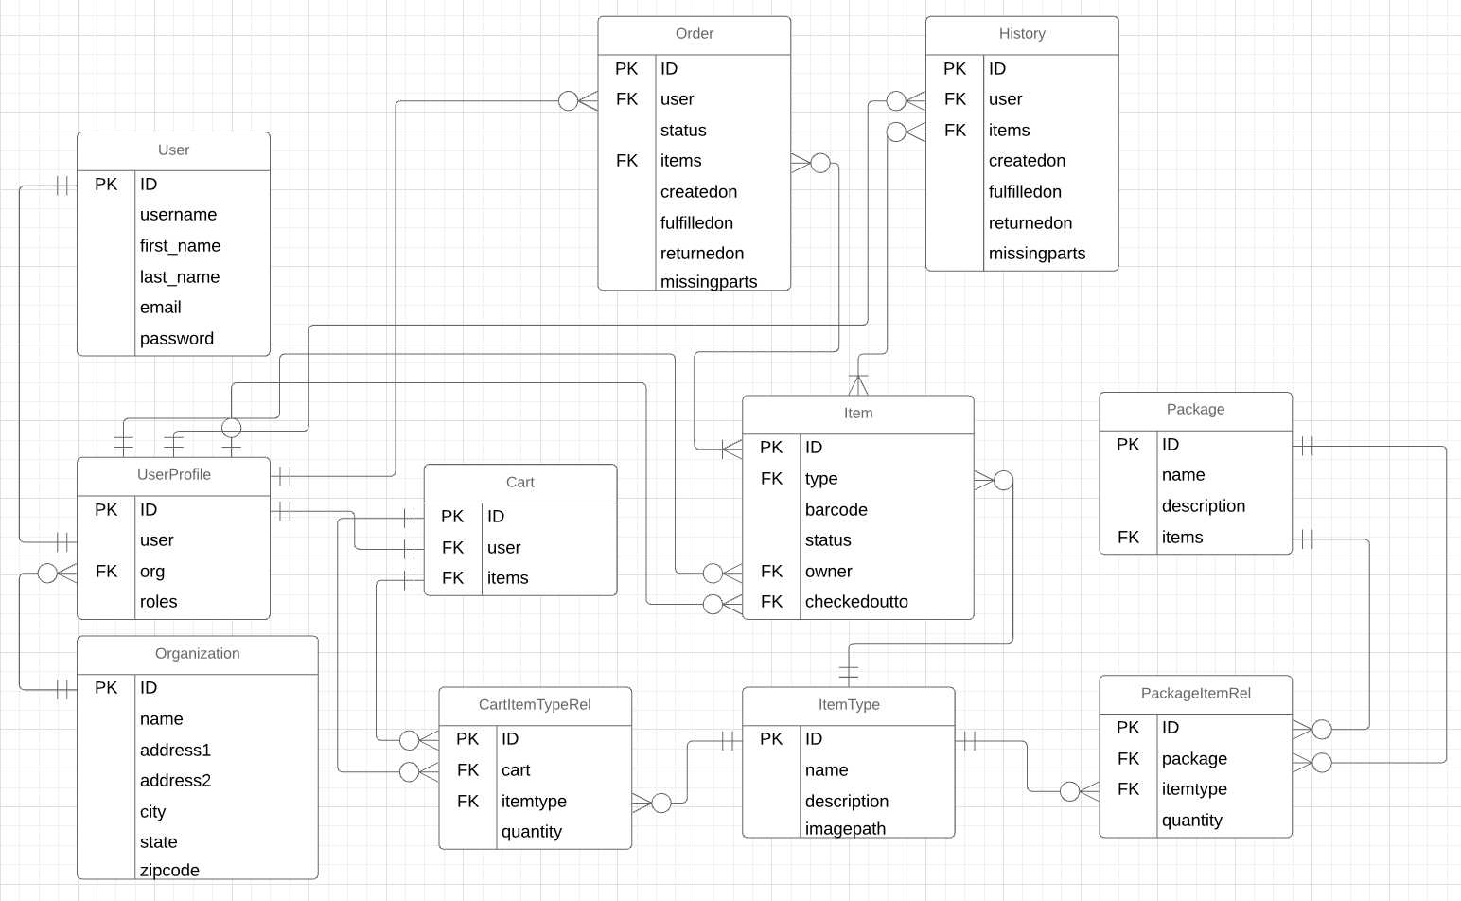
Outcomes
Implemented our database schema within “models.py”.
Began connecting Django model to usable views for the frontend.

Slide 6
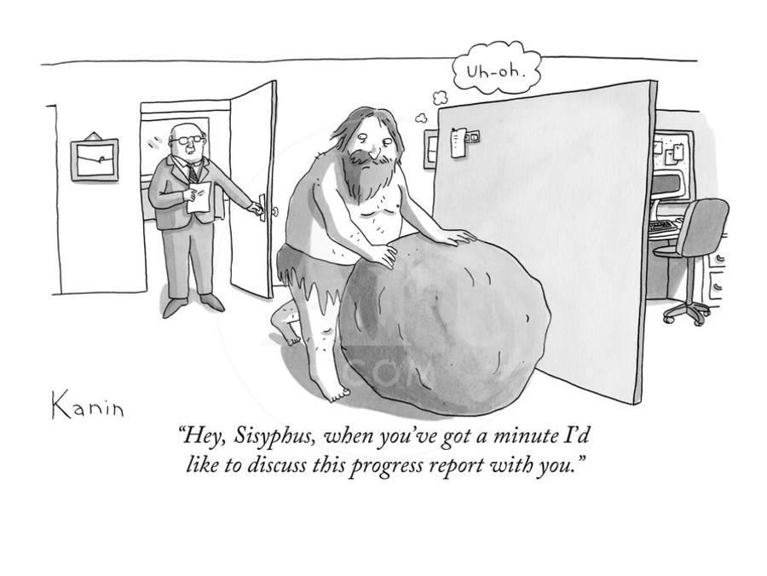
Hinderances
Our team’s lack of experience in the frameworks has made progress slow.
The initial size of the codebase has made trimming out unneeded pieces difficult.
Implementing communication between the frontend and backend has proven difficult.
Once this is functional we expect our frontend development to pick up pace.

Slide 7
Ongoing Risks
Risk | Impact | Likelihood
Inexperience with Frameworks and Syntax | 6 | 7
Complexity of Framework Documentation | 5 | 6
Little Documentation in Existing Codebase | 4 | 7
Illness of team member(s) | 4 | 4
Hardware Failure | 5 | 2
Act of God | 8 | 1

Slide 8
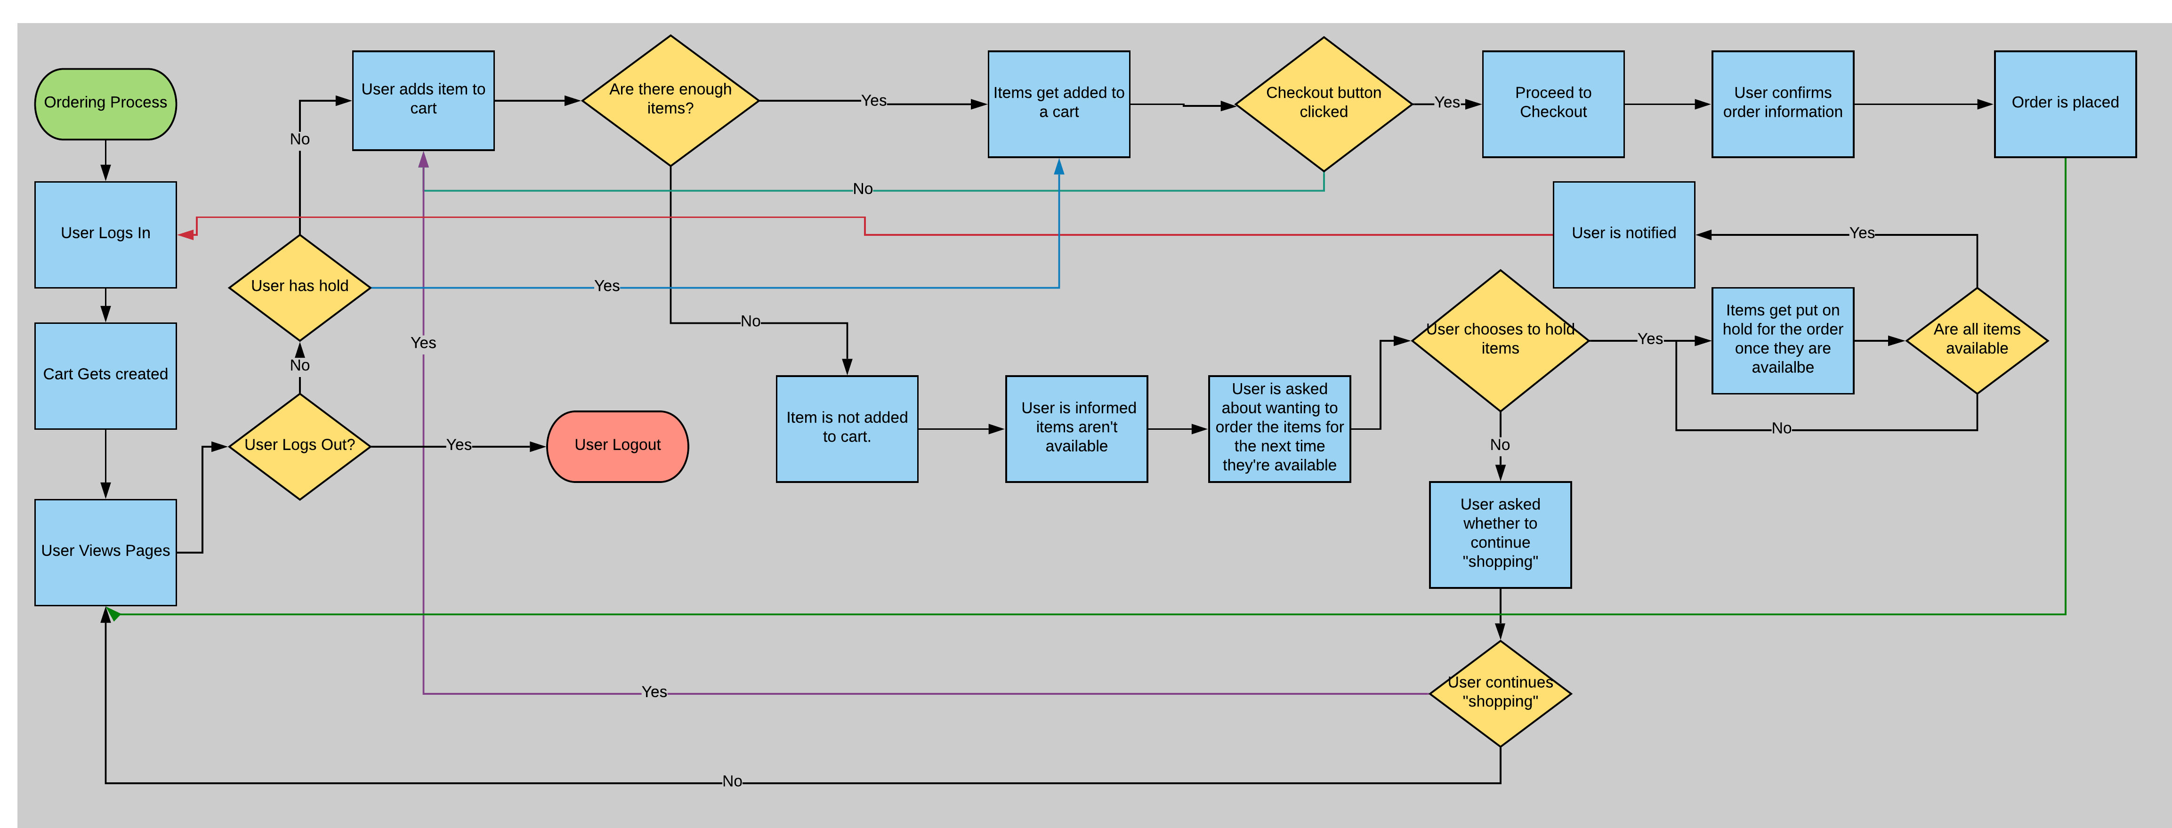
Ordering Process Diagram

Slide 9
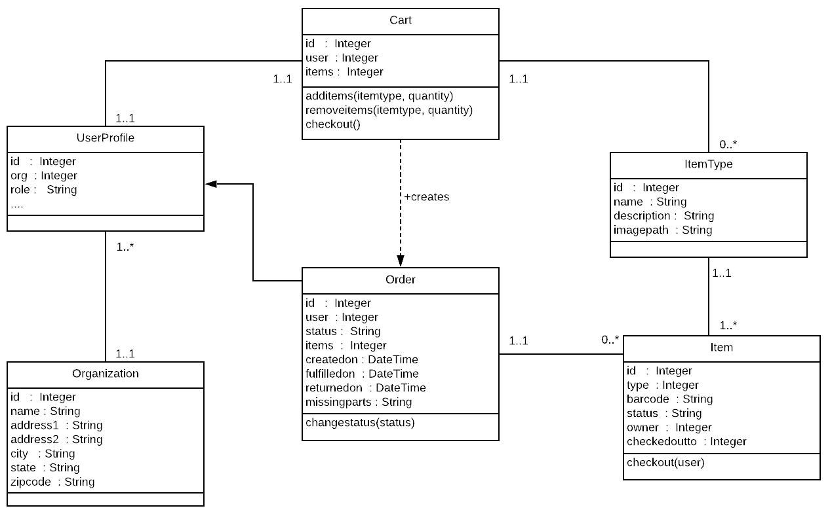
C4 Diagram

Slide 10
Questions?

